Slide 1
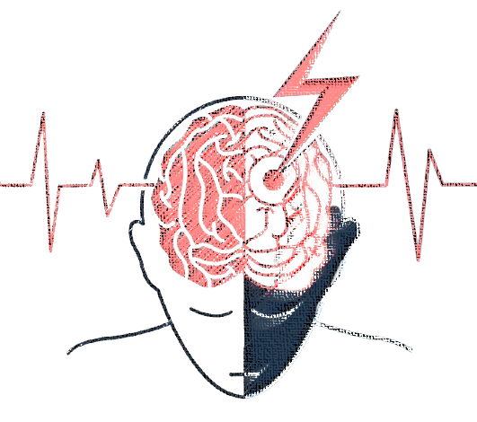
DATS 6103 STROKE PREDICTION
TEAM MEMBERS: Aswin Balaji Thippa Ramesh Barathkumar Anantharaj Gowri Sriram Lakshmanan Rahul Arvind

Slide 2
PURPOSE
Summarize important background research and EDA
Answer the SMART questions by building plots & models

Slide 3

SMART QUESTIONS
What are the key factors most strongly associated with the occurrence of strokes?
How does each predictor's distribution differ between different stroke cases ?
Can we determine statistically significant correlations or patterns in stroke occurrence based on categorical variables?
Can we identify trends or variations in stroke risk based on time-related factors like age?
How accurate is it on building a machine learning model predict stroke occurrence based on the dataset?

Slide 4

DATASET DETAILS
Stroke Prediction dataset sourced from Kaggle
Dataset contains,
5100 observations
11 variables
Personal Details: Age, Gender, Work Type, Marital Status, Residence Type
Health Metrics specifics: BMI, Heart Disease, Hypertension, Glucose Level
Target Variable : Stroke

Slide 5
DATASET DETAILS
Stroke Prediction dataset
Dataset is imbalanced
Heavily Biased
95% 5%
STROKE = 0 | STROKE = 1
4861 | 249

Slide 6
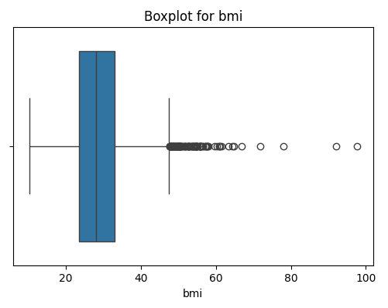
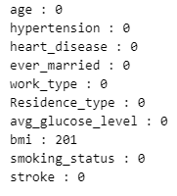
EXPLORATORY DATA ANALYSIS (EDA)
PREPROCESSING RESULT :
Missing values in “BMI” column (Filled with mean)
No redundant rows
Has outliers but useful

Slide 7
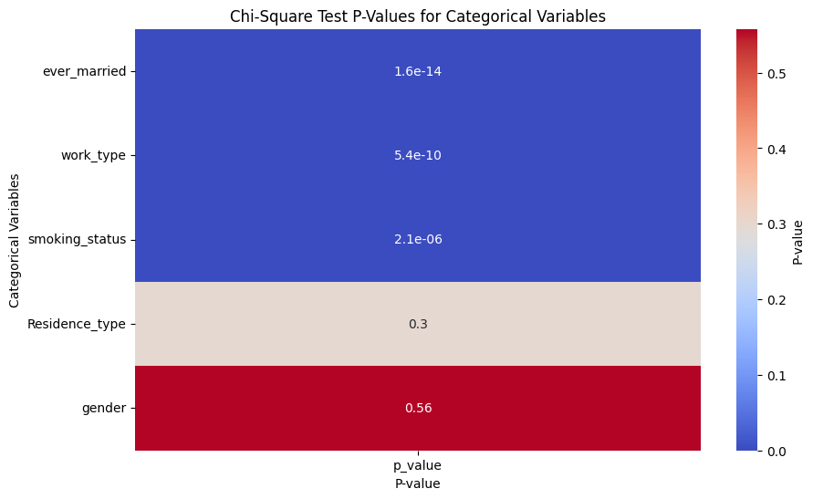
EXPLORATORY DATA ANALYSIS (EDA)
Can we determine statistically significant correlations in stroke occurrence based on categorical variables?
Yes, some variables are statistically significant based on the result obtained from Chi-square test.

Slide 8
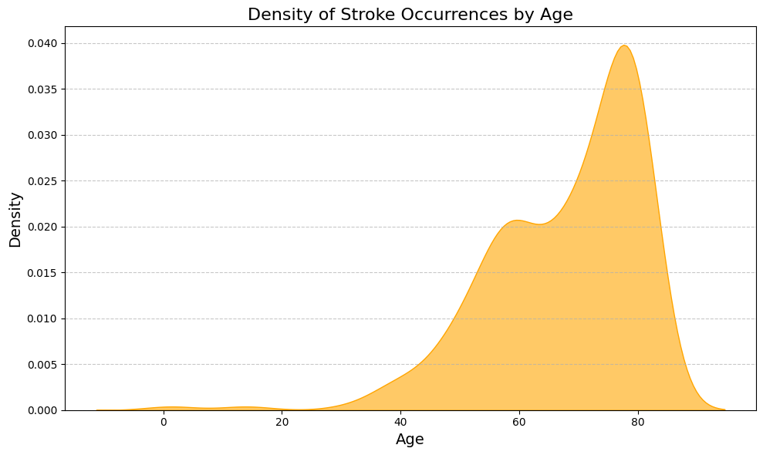
EXPLORATORY DATA ANALYSIS (EDA)
Can we identify trends or variations in stroke risk based on time-related factors like age?
Stroke occurrences increase significantly after the age of 40, with higher frequencies observed in older age groups especially between 70 to 85.

Slide 9
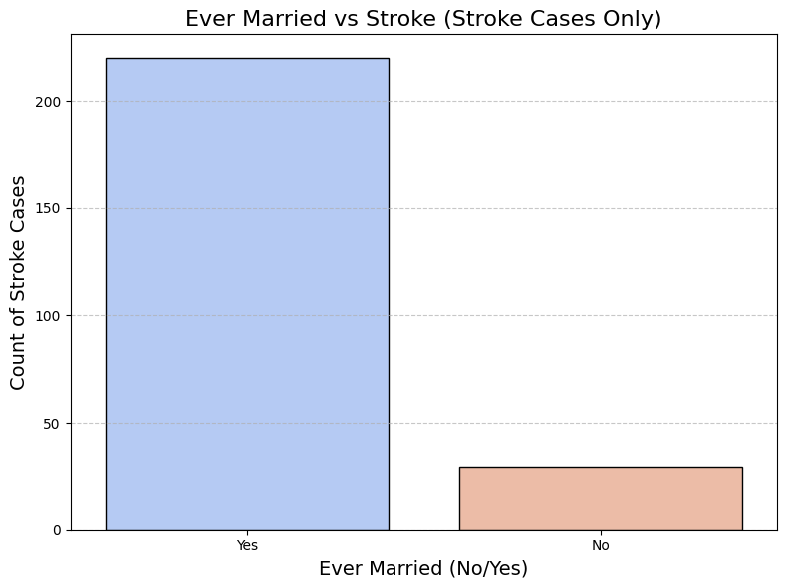
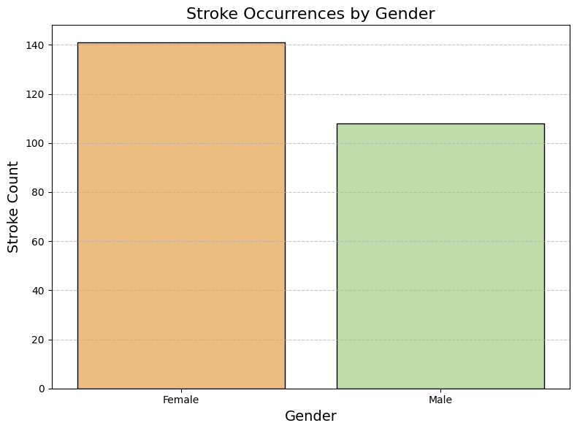
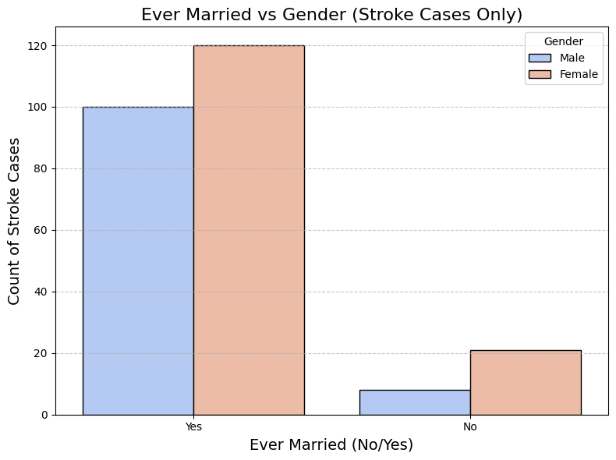
EXPLORATORY DATA ANALYSIS (EDA)
How does the distribution of each predictor vary within stroke cases?
Most stroke cases are tied to being married, especially among women.

Slide 10
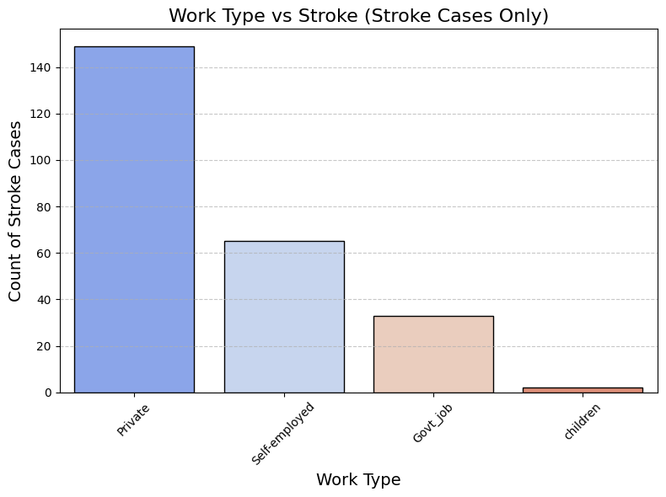
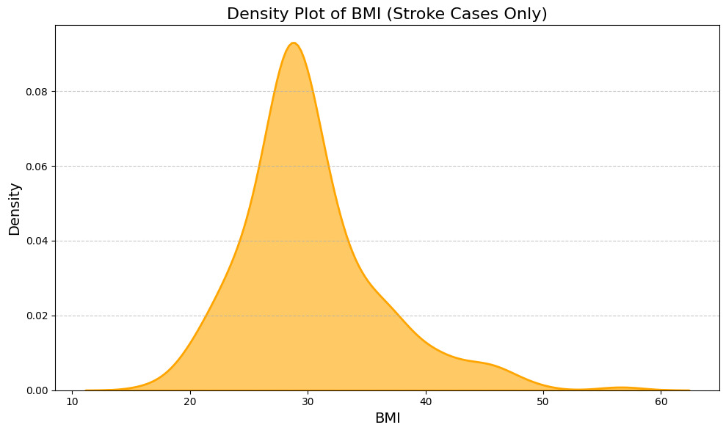
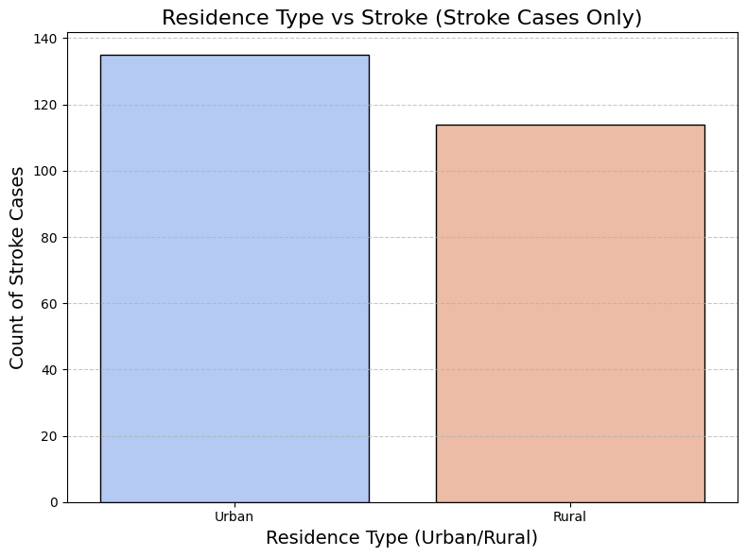
EXPLORATORY DATA ANALYSIS (EDA)
How does the distribution of each predictor vary within stroke cases?
Stroke cases are more common among private sector workers, higher BMI (20-40) ranges, and urban residents.

Slide 11
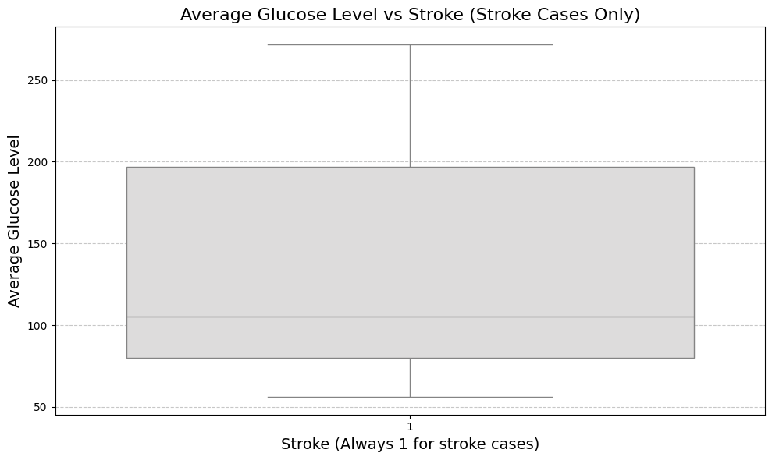
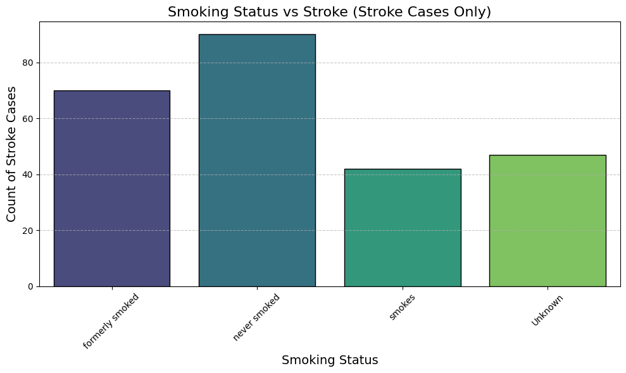
EXPLORATORY DATA ANALYSIS (EDA)
How does the distribution of each predictor vary within stroke cases?
Stroke cases are associated with glucose level between 70 to 200 and are among those who have never smoked, followed by former smokers.

Slide 12
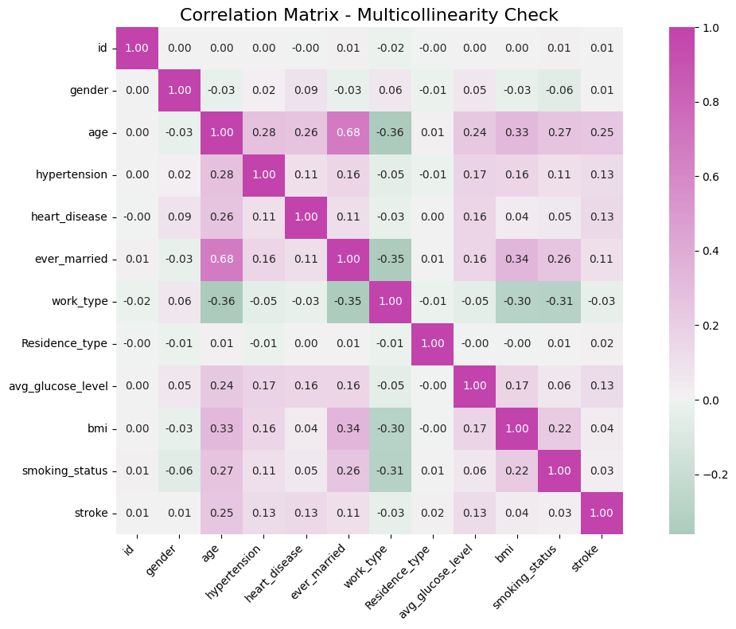
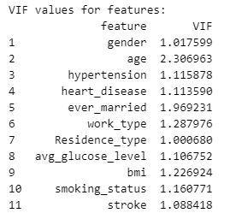
EXPLORATORY DATA ANALYSIS (EDA)
Multicollinearity & Correlation Check
No independent columns are collinear with each other

Slide 13
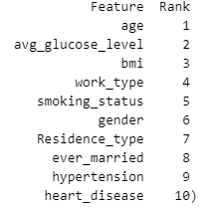
MODEL BUILDING
RANKING PREDICTORS
What are the key factors most strongly associated with the occurrence of strokes?
Applied RFE Technique
RFE technique is used to eliminate the least important ones iteratively.
Ranked variables based on its importance

Slide 14
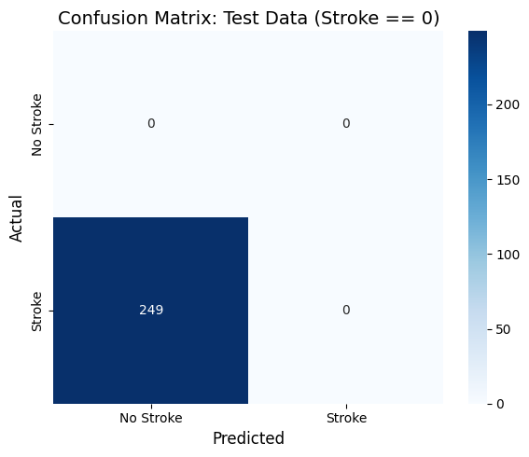
MODEL BUILDING
LOGISTIC REGRESSION WITH IMBALANCED DATA
0% Accuracy with the test data of stroke prediction
100% Accuracy with the test data of non-stroke prediction

Slide 15
MODEL BUILDING
BALANCING THE DATA
Applied SMOTE for oversampling.
Balanced the dataset for equal class representation.
Reduced bias in stroke predictions.
SMOTE generates synthetic samples for the minority class to balance class distribution.
BEFORE
STROKE = 0 | STROKE = 1
4861 | 249
AFTER
STROKE = 0 | STROKE = 1
4861 | 4861

Slide 16
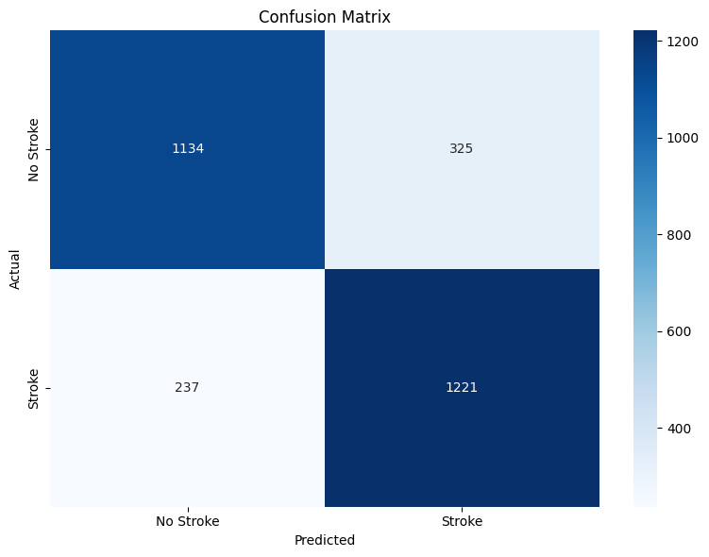
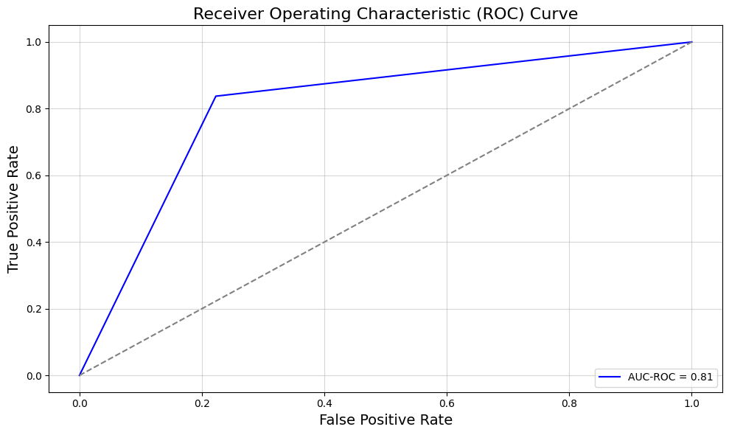
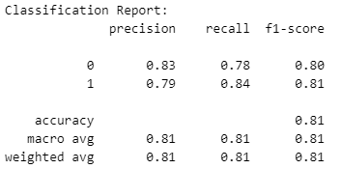
MODEL BUILDING
LOGISTIC REGRESSION WITH BALANCED DATA
Train Accuracy : 100%
Test Accuracy : 81%

Slide 17
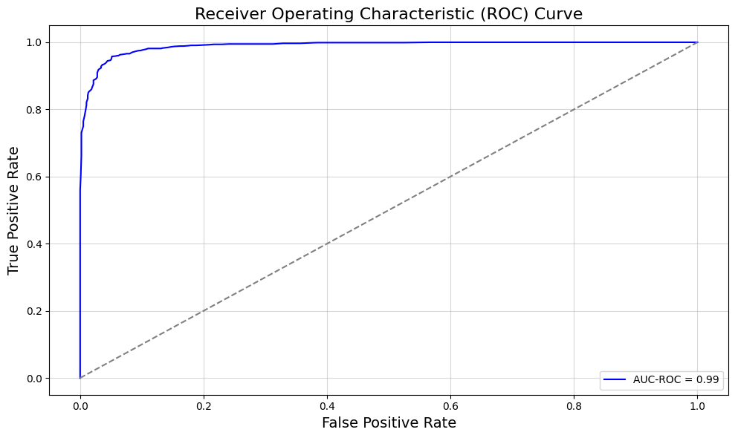
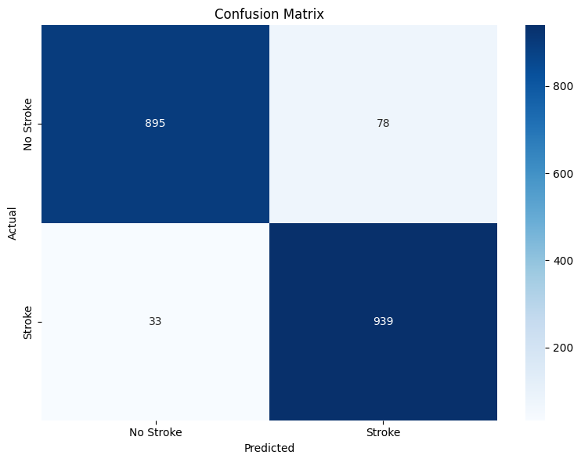
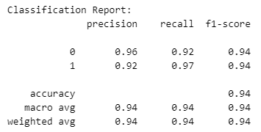
MODEL BUILDING
RANDOM FOREST WITH BALANCED DATA
Train Accuracy : 99%
Test Accuracy : 94%

Slide 18
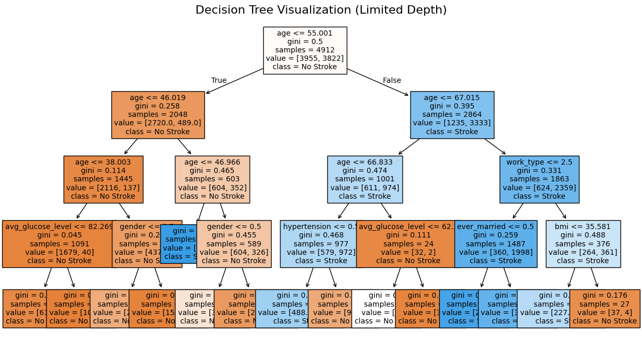
MODEL BUILDING
RANDOM FOREST WITH BALANCED DATA

Slide 19

MODEL COMPARISON
MODEL | BALANCED | ACCURACY
Logistic Regression | No | 0%
Logistic Regression | Yes | 81%
Random Forest | Yes | 94%

Slide 20
CONCLUSION
The analysis reveals key insights into stroke occurrence patterns:
Key Predictors: Age, average glucose level, BMI, work type and gender are the strongest factors of stroke prediction.
Model Performance: The Random Forest model on balanced data outperforms the LR model with higher accuracy (94%) and lower error rates.
Actionable Insights: Stroke risks rise after age 40, with higher cases among urban residents, private workers, BMI 20–40, and females. Elevated glucose levels and lifestyle factors like smoking also play key roles.

Slide 21

Any thoughts or suggestions?

